Slide 1

BITS, PILANI – K. K. BIRLA GOA CAMPUS
Operating Systems
(CS C372 & IS C362)
by
Mrs. Shubhangi Gawali
Dept. of CS and IS

Slide 2
Fair-Share Scheduling
User’s application runs as a collection of processes (threads)
User is concerned about the performance of the application
Need to make scheduling decisions based on process sets
Scheduling decisions could then be made that attempt to give each group similar service.
Each user is assigned a weight of some sort that defines that user’s share of system resources as a fraction of the total usage of those resources.
Objective: monitor resource usage

Slide 3
Example
Consider three groups (1,2,3) containing three,
two, and four users respectively, the available
CPU cycles will be distributed as follows:
100% / 3 groups = 33.3% per group
Group 1: (33.3% / 3 users) = 11.1% per user
Group 2: (33.3% / 2 users) = 16.7% per user
Group 3: (33.3% / 4 users) = 8.3% per user
Notes:
The system divides the user community into a set of
fair-share groups and allocates a fraction of the processor resource to each group.
Thus, there might be four groups, each with 25% of the processor usage. In effect,
each fair-share group is provided with a virtual system that runs proportionally
slower than a full system.

Slide 4
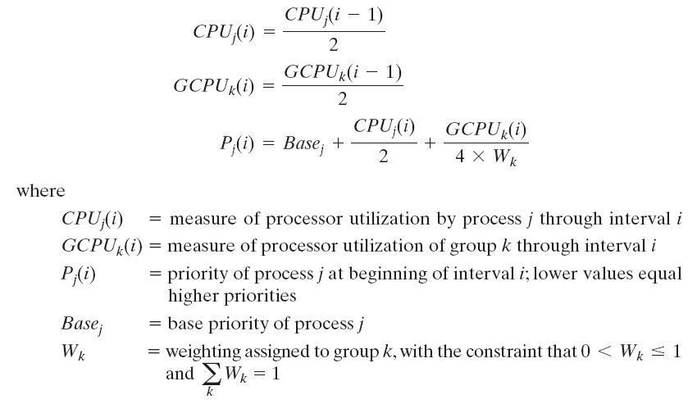
Priority calculation
The following formulas apply for process j in group k:
Notes:
FSS considers the execution history of a related group of processes, along with the individual execution history of each process in making scheduling decisions.
Scheduling is done on the basis of priority.
Each process is assigned a priority which takes into account the base priority of the process, its recent processor usage, and the recent processor usage of the group to which the process belongs.
The higher the numerical value of the priority, the lower the priority.
The following formulas apply for process j in group k:
The priority of a process drops as the process uses the processor and as the group to which the process belongs uses the
processor. In the case of the group utilization, the average is normalized by dividing by the weight of that group.
The greater the weight assigned to the group, the less its utilization will affect its priority.

Slide 5
Example
Consider process A is in one group and process B and process C are in a second group, with each group having a weight of 0.5.
Assume that all processes are processor bound and are usually ready to run.
All processes have a base priority of 60.
Processor utilization is measured as follows:
  The processor is interrupted 60 times per second;
  During each interrupt, the processor usage field of the currently running process is incremented, as is the corresponding group processor field.
  Once per second, priorities are recalculated.

Slide 6
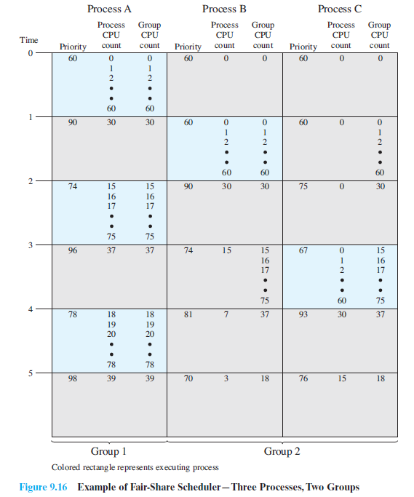

Notes:
In the figure, process A is scheduled first. At the end of one second, it is preempted.
Processes B and C now have the higher priority, and process B is scheduled.
At the end of the second time unit, process A has the highest priority. Note that the
pattern repeats: the kernel schedules the processes in order: A, B, A, C, A, B, and so
on. Thus, 50% of the processor is allocated to process A, which constitutes one
group, and 50% to processes B and C, which constitute another group.

Slide 7
Traditional UNIX Scheduling
Time sharing interactive environment
Goal
  Good response time for interactive users while ensuring that low priority background processes do not starve
Multilevel feedback using round robin within each of the priority queues
If a running process does not block or complete within 1 second, it is preempted
Priorities are recomputed once per second
Notes:
Although this algorithm has been replaced in modern UNIX systems, it is
worthwhile to examine the approach because it is representative of practical timesharing
scheduling algorithms.

Slide 8
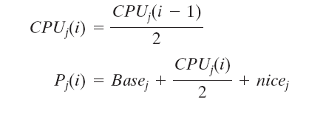
Traditional UNIX Scheduling
Priority is based on process type and execution history
Base priority divides all processes into fixed bands of priority levels
CPU and nice components are restricted to prevent a process from migrating out of its assigned band
Where CPUj(i) = measure of processor utilization by process j through interval i
Pj(i) = priority of process j at beginning of interval i; lower values equal higher priorities
Basej = base priority of process j
nicej = user-controllable adjustment factor
Notes:
Priority is based on process type and execution history

Slide 9
Bands
Decreasing order of priority
  Swapper
  Block I/O device control
  File manipulation
  Character I/O device control
  User processes
Notes:
This hierarchy should provide the most efficient use of the I/O devices.
Within the user process band, the use of execution history tends to penalize
processor-bound processes at the expense of I/O-bound processes. Again, this
should improve efficiency. Coupled with the round-robin preemption scheme, the
scheduling strategy is well equipped to satisfy the requirements for general-purpose
time sharing.

Slide 10
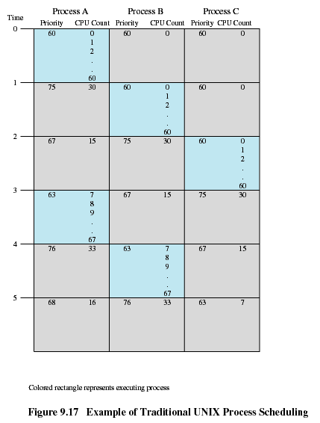
Notes:
An example of process scheduling is shown in Figure 9.17. Processes A, B,
and C are created at the same time with base priorities of 60 (we will ignore the nice
value). The clock interrupts the system 60 times per second and increments a
counter for the running process. The example assumes that none of the processes block themselves and that no other processes are ready to run. Compare this with Figure 9.16.

